Slide 1

Python WORKSHOP

Slide 2
title
PENALTY SOCCER game

Slide 3

team name
RAMPAGE’S SOCCER TEAM

Slide 4
Team number
15

Slide 5
TEAM MEMBERS
ABISHRAJ.K (ER) [18IT01]
ALTEN.C (ER) [18IT02]
ANUSUYA (ER) [18IT03]

Slide 6
ACADEMIC MENTOR :
(ER) SATHISH.R M.E.,(PhD).,
Assistant professor,
Dept of IT.KITE

Slide 7
INDUSTRY MENTOR
MS SUBASHINI (ER) .,B.E.

Slide 8
ABSTRACT
The title of our game is penalty soccer game .This project is about a penalty game in football . This project was developed by using python pygame . There are one players in the game . We are focusing developing a 2D Penalty Soccer Game . Each player will have a 5 penalty shoots. In this game Goal Keeper will save the ball or allow the ball . If Goal Keeper allow the ball the point will increase by 1 for each player . If Goal Keeper save the ball the point will not increase and decrease for each player.In order to improve the match success rate, we proposed a penalty kick strategy based on two-player shooting method which is used in two different defense patterns. In this strategy, a shooting method is applied when the opponent goalkeeper run out to destroy the ball and a reflecting shooting method is used when the goalkeeper stays at the goal line.

Slide 9
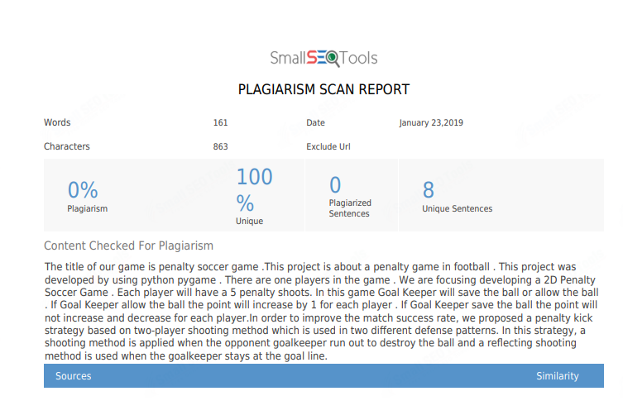

Slide 10
MODULES
GAME TYPE : PENALTY SOCCER GAME
PLAYERS : ONE PLAYER
LEVEL : ONE LEVEL
PENALTY SHOOT : EACH PLAYER HAS 5 SHOOT
TIME : THERE IS NO TIME
SCORE : BASED ON GOAL WE CALCULATE THE SCORE

Slide 11
REQUIREMENTS
SOFTWARE :
THONNY
LANGUAGE :
PYTHON

Slide 12
SAMPLE CODE
m = pygame.image.load('images/lmanit.png')
point = pygame.image.load('images/point.png')
back = pygame.image.load('images/back.png')
frnt_1 = pygame.image.load('images/front-1.jpg')
img_instr = pygame.image.load('images/intro.png')
img_play1 = pygame.image.load('images/Play.png')
home_icn = pygame.image.load('images/home.png')
home_icn1 = pygame.image.load('images/home1.png')
icn = pygame.image.load('images/icon.jpg')
img_sky = pygame.image.load('images/sky2.png')
banner = pygame.image.load('images/BANNER.png')
img_goalpost = pygame.image.load('images/goalpost.png')
img_aud = pygame.image.load('images/audi.png')
line1 = pygame.image.load('images/line.png')
line2 = pygame.image.load('images/boundry.png')

Slide 13
MODEL ARCHITECTURE
Start the game
Two players
Player 1 shoot the ball
Goal keeper allow or save the ball
Player 2 shoot the ball
Goal keeper allow or save the ball
After 5 shoots for each player
End the game.

Slide 14
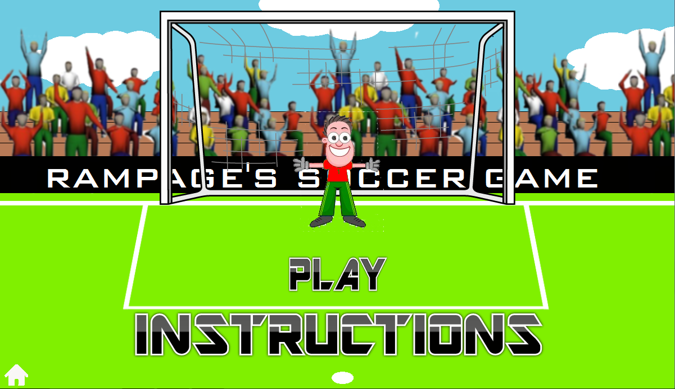
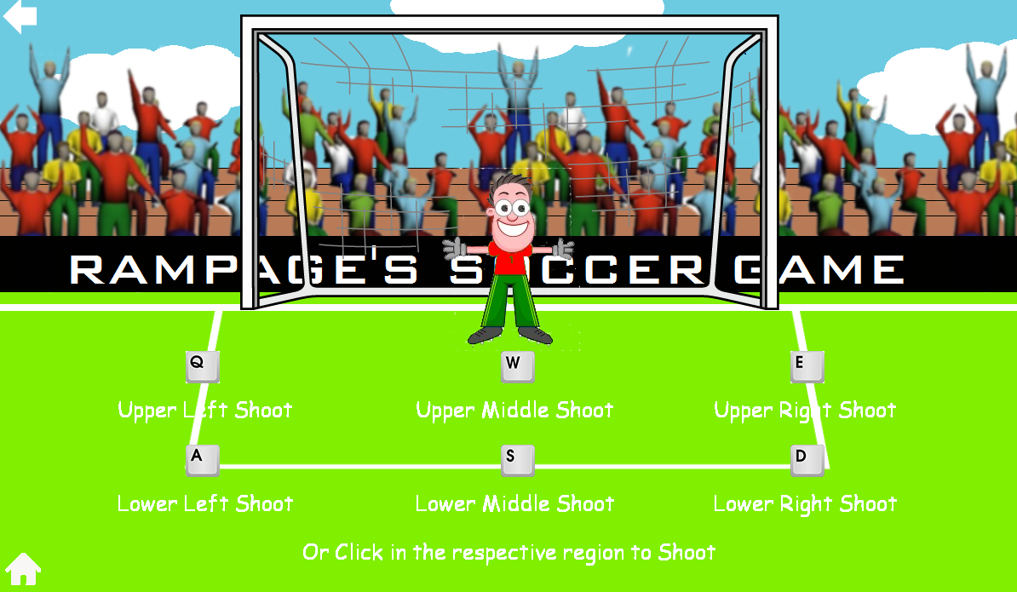
pygame

Slide 15
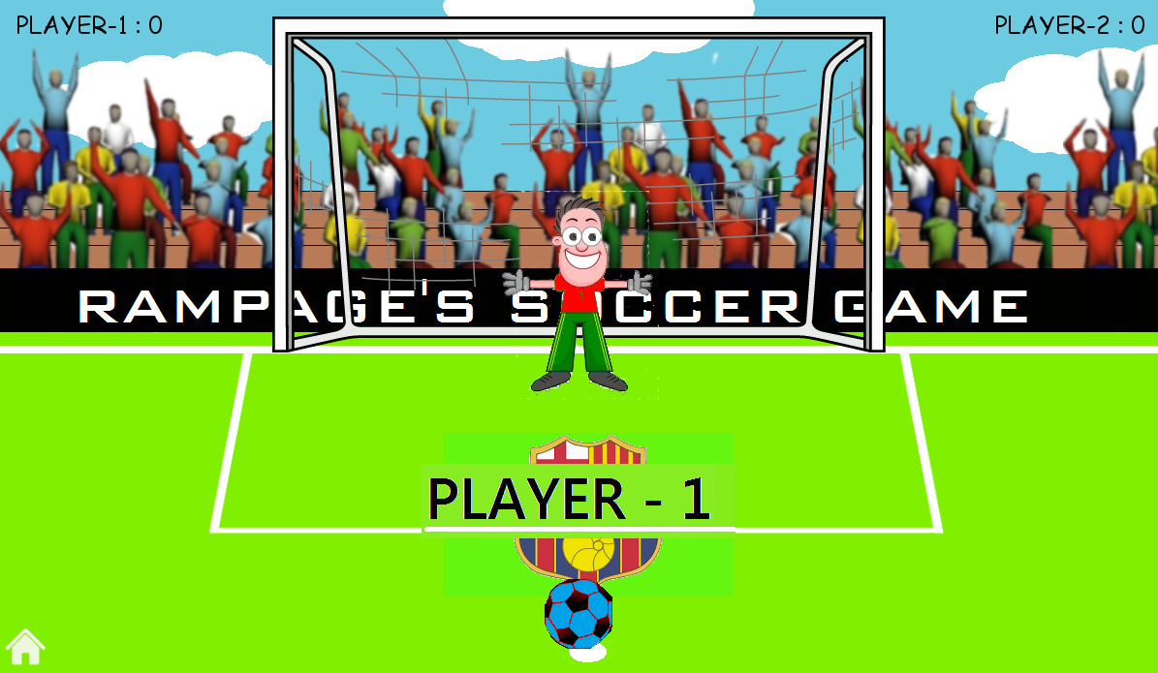
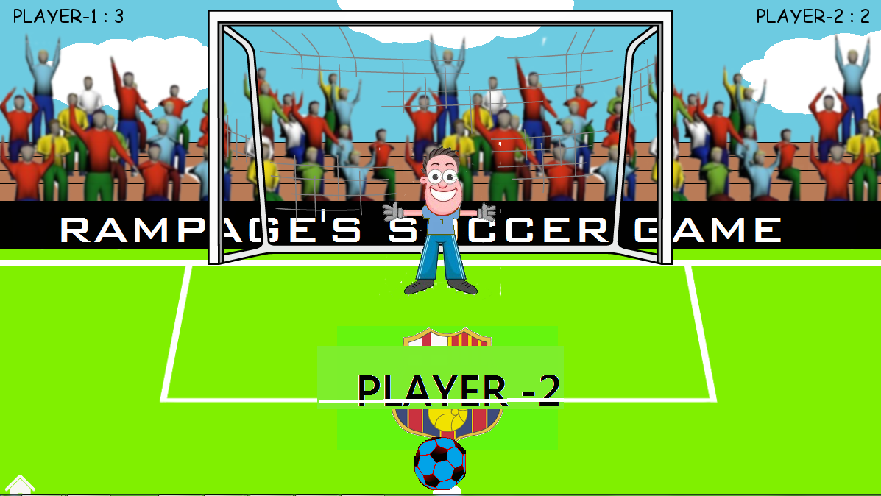
PYGAME

Slide 16
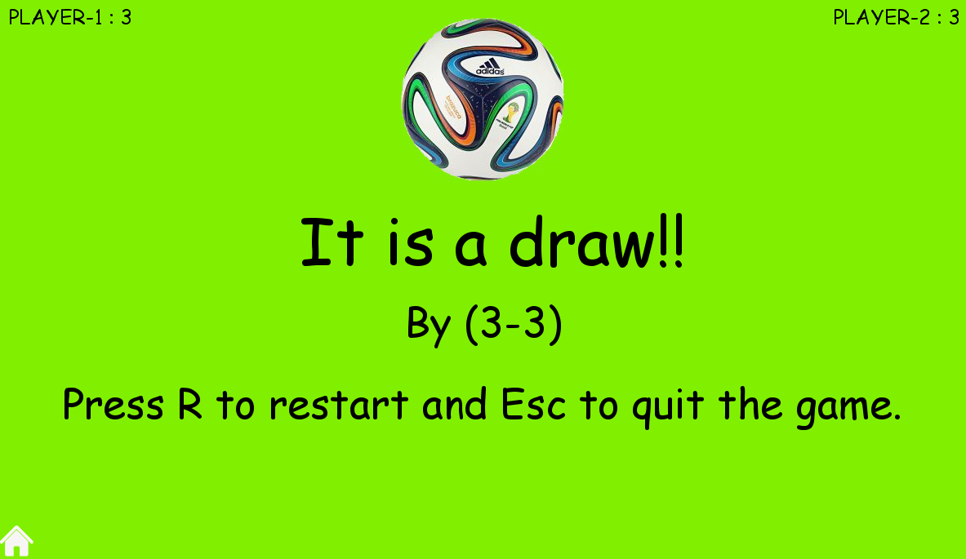
PYGAME

Slide 17
Thank you…….

